Slide 1
AGRIINTEL
AI-Powered Agricultural Intelligence & Decision Support System
Data Analytics • Machine Learning • Business Intelligence

Slide 2
AGENDA
01
02
03
04
05
PROJECT OVERVIEW
DATA & ENGINEERING
MACHINE LEARNING & AI
DASHBOARDS & INSIGHTS
RESULTS & FUTURE
Problem statement, objectives, technology stack & system architecture
Dataset overview, preprocessing pipeline & feature engineering
ML pipeline, Random Forest model & AI recommendation engine
Streamlit dashboard, Power BI reports & business insights
Model evaluation, future scope & conclusion

Slide 3
THE PROBLEM: FARMING WITHOUT DATA
Agriculture generates massive amounts of crop, soil, and weather data, but farmers struggle because data is scattered and difficult to interpret.
KEY CHALLENGES
THE CORE ISSUE
Low Crop Productivity
Incorrect Crop Planning
Experience-based decisions miss optimization opportunities
Lack of data-driven crop selection for conditions
Traditional farming relies on experience over data, creating a gap between available agricultural intelligence and actual decision-making on the ground.
Inefficient Fertilizer Usage
Yield Uncertainty
Over or under-application wastes resources and harms soil
Farmers cannot reliably predict harvest outcomes
Poor Resource Management
Water, land, and inputs are not allocated optimally
221,208+
Agricultural Records Analyzed
03 / 20

Slide 4
PROJECT OBJECTIVES
AgriIntel assists farmers and agricultural organizations by providing:
Crop Yield Prediction
Fertilizer Recommendation
Production Analytics
Weather Analysis
AI-powered forecasting of crop yields based on soil, weather, and historical data
Smart nutrient recommendations tailored to soil conditions and crop type
Comprehensive analysis of agricultural production patterns and trends
Weather pattern intelligence for informed farming decisions
Soil Analysis
Decision Support
Interactive Dashboards
BI Reports
Deep soil nutrient profiling including N, P, K levels and pH analysis
Intelligent recommendations powered by machine learning algorithms
Real-time visual dashboards with filters and drill-down capabilities
Executive business intelligence reports for stakeholders
04 / 20

Slide 5
TECHNOLOGY STACK
PROGRAMMING
MACHINE LEARNING
INFRASTRUCTURE
● Python
DATA ANALYSIS
● Pandas
● NumPy
VISUALIZATION
● Matplotlib
● Seaborn
● Scikit-Learn
MODEL
● Random Forest Regressor
DASHBOARD
● Streamlit
BI TOOL
● Power BI Desktop
STORAGE
● Structured Data Records
● Prediction Results
● Recommendation Dataset
05 / 20

Slide 6
PROJECT WORKFLOW
01
COLLECT DATA
02
STORE IN CSV
03
CLEAN DATA
04
FEATURE ENG.
05
TRAIN ML MODELS
09
VISUALIZE INSIGHTS
08
ASSIGN PRIORITY
07
FERTILIZER RECOMMEND
06
YIELD PREDICTION
WORKFLOW DETAILS
Data Phase
01 Collect agricultural data from multiple sources
02 Store data inside CSV Files
03 Clean the dataset (missing values, duplicates)
ML Phase
04 Feature Engineering (40+ features)
05 Train Random Forest Regressor
06 Generate Yield Predictions
Output Phase
07 Generate Fertilizer Recommendations
08 Assign Priority Levels
09 Visualize via Streamlit & Power BI
07 / 20

Slide 7
DATASET OVERVIEW
221,208+
40+
35
55
Total Records
Features
States
Crop Types
KEY FEATURES
Category | Feature 1 | Feature 2 | Feature 3 | Feature 4
Location | State | District | Area | Season
Crop Data | Crop Type | Production | Yield | Crop Year
Weather | Rainfall | Temperature | Humidity | Weather Category
Soil | Soil pH | Nitrogen | Phosphorus | Potassium
Output | Fertilizer | Predicted Yield | Recommendation | Priority
08 / 20

Slide 8
DATA PREPROCESSING
Ensuring high-quality data for accurate model training
Missing Value Handling
Duplicate Removal
Data Cleaning
Imputation and removal strategies for incomplete records
Eliminating redundant entries to prevent data bias
Outlier detection, format standardization, and noise reduction
Feature Selection
Feature Engineering
Data Transformation
Selecting the most relevant features for model performance
Creating new derived features to improve prediction accuracy
Scaling, normalization, and encoding for ML readiness
LABEL ENCODING
Categorical variables (State, District, Crop, Season, Fertilizer) were encoded using label encoding where required, converting text categories into numerical representations suitable for machine learning algorithms.
09 / 20

Slide 9
FEATURE ENGINEERING
Engineered features that significantly improved model performance
Production per Hectare
Area Yield
Predicted Yield
Normalized production metric for fair comparison across different farm sizes
Yield calculation based on cultivated area for productivity benchmarking
ML-generated yield forecast used as a feature for recommendation engine
Yield Category
Weather Categories
Humidity Category
Categorical classification of yield ranges for simplified analysis
Grouped weather conditions into actionable classification buckets
Classified humidity levels to correlate with crop performance
Priority Classification
Absolute Error & Prediction Error
Assigned priority levels (Immediate Action, High, Moderate, Routine) based on yield prediction and soil conditions
Error metrics to continuously evaluate and improve prediction quality
Impact: These engineered features significantly improved model performance, enabling more accurate yield predictions and better fertilizer recommendations for farmers.
10 / 20

Slide 10
MACHINE LEARNING PIPELINE
TRAINING PROCESS
RAW DATA
CLEANING
FEATURE ENG.
TRAIN-TEST SPLIT
RANDOM FOREST
PREDICT
DEPLOY
RANDOM FOREST REGRESSOR
EVALUATION METRICS
Why Random Forest?
● Handles high-dimensional agricultural data effectively
● Robust to outliers and missing values
● Provides feature importance rankings
● Reduces overfitting through ensemble averaging
● Excellent performance with mixed data types
MAE
RMSE
Low
Low
Mean Absolute Error measures average prediction accuracy
Root Mean Square Error penalizes large prediction errors
R² SCORE
High
Coefficient of determination indicates strong model fit
11 / 20

Slide 11
AI RECOMMENDATION ENGINE
INPUT PARAMETERS
OUTPUT
● Soil Nutrients — N, P, K levels and pH values
● Weather Conditions — Rainfall, temperature, humidity
● Crop Type — Specific crop being cultivated
● Location — State and district information
● Season — Kharif, Rabi, or Whole Year
● Predicted Yield — ML-generated yield forecast
● Recommended Fertilizer
● Priority Classification
The engine analyzes all input parameters and generates a tailored fertilizer recommendation along with an action priority level to guide farming decisions.
PRIORITY LEVELS
IMMEDIATE ACTION
HIGH PRIORITY
MODERATE PRIORITY
ROUTINE MONITORING
Priority is determined based on predicted yield deviation from optimal, soil nutrient deficiency severity, and weather risk factors
12 / 20

Slide 12
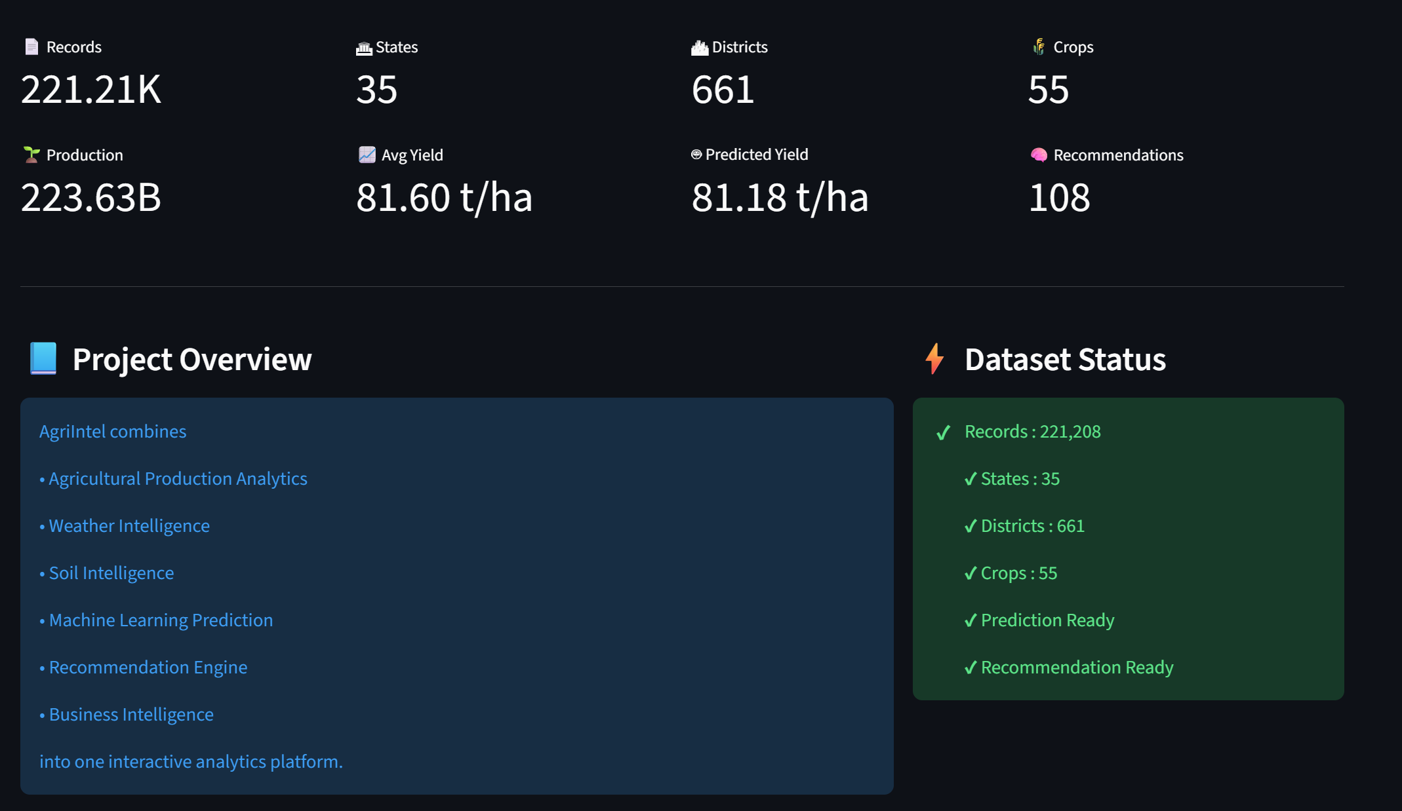
STREAMLIT DASHBOARD
Executive KPIs Overview — Real-time metrics showing 221.21K records, 35 states, 661 districts, 55 crops, 223.63B production, 81.60 t/ha average yield, and 108 recommendations
14 / 20

Slide 13
POWER BI DASHBOARD
EXECUTIVE BI DASHBOARD
BUSINESS INTELLIGENCE
Business intelligence dashboard designed for executives and decision-makers
Power BI transforms raw agricultural data into actionable business intelligence for stakeholders
KPIs
● Dataset Records
● States, Crops, Districts
● Seasons and Years coverage
TARGET AUDIENCE
● Agricultural Officers
● Government Departments
● Policy Makers
● AgriTech Companies
● Research Organizations
CHARTS
● Production by State
● Top Crops Analysis
● Season Distribution
● Fertilizer Distribution
● Prediction Error Analysis
● Priority Distribution
Purpose: Enable data-driven policy decisions and strategic agricultural planning at scale
15 / 20

Slide 14
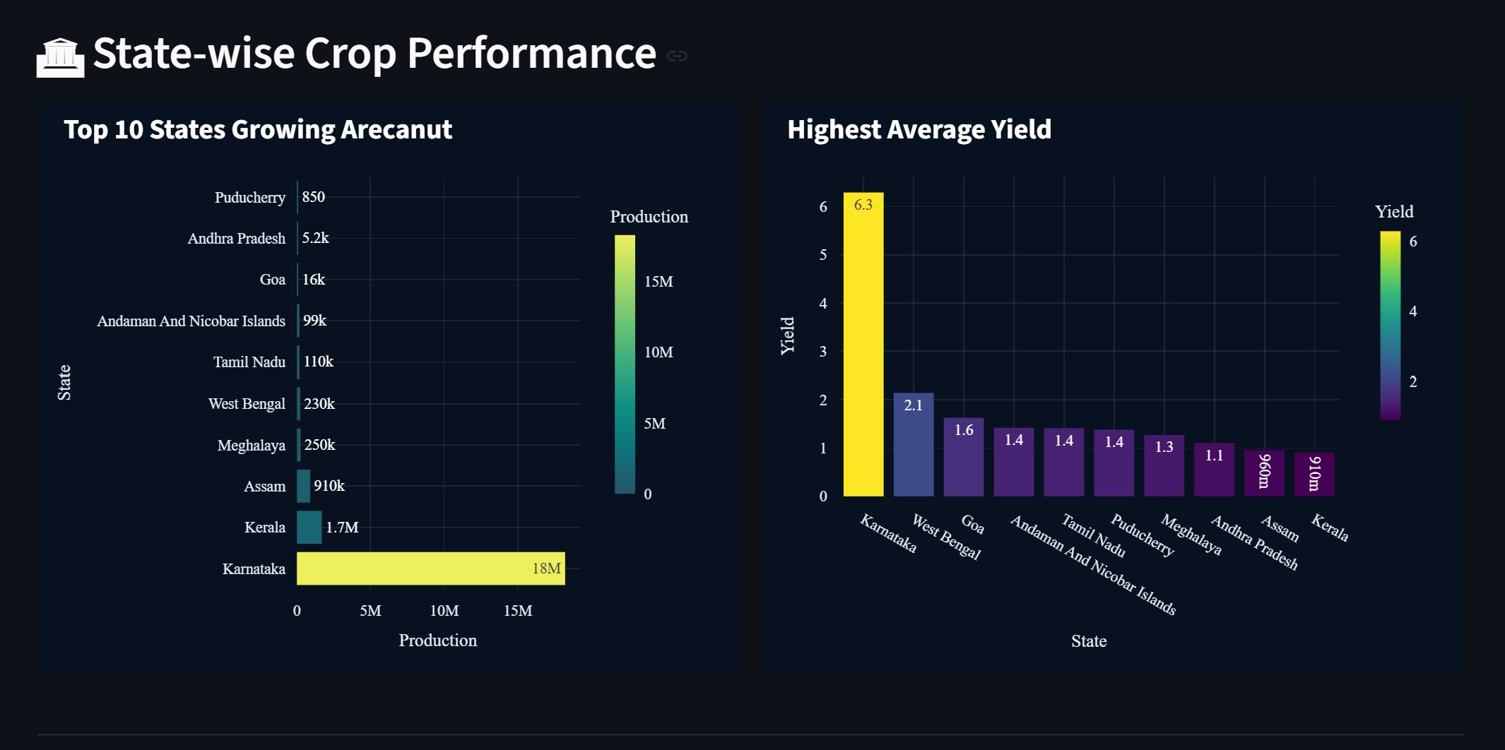
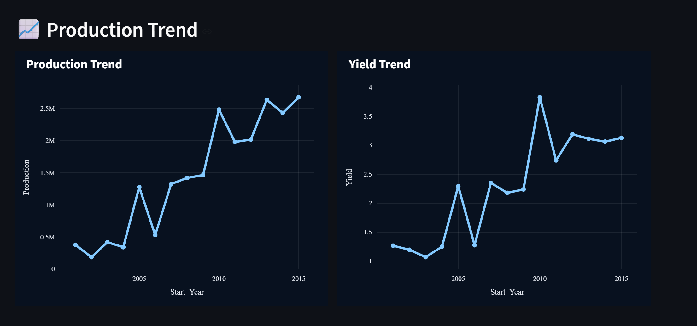
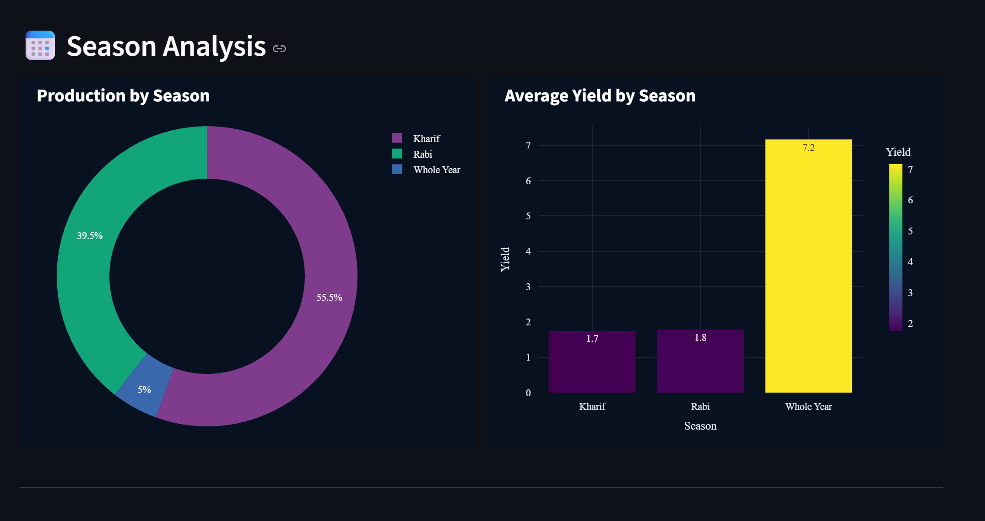
BUSINESS INSIGHTS
State-wise Crop Performance
Production & Yield Trends
Season Analysis
KEY FINDINGS
✔ Highest Yield States identified for benchmarking
✔ Top Performing Crops ranked by region
✔ Seasonal Trends analyzed for planning
✔ Fertilizer Demand mapped across states
✔ Priority Recommendations generated automatically
✔ Prediction Performance continuously evaluated
✔ Production Distribution visualized geographically
16 / 20

Slide 15
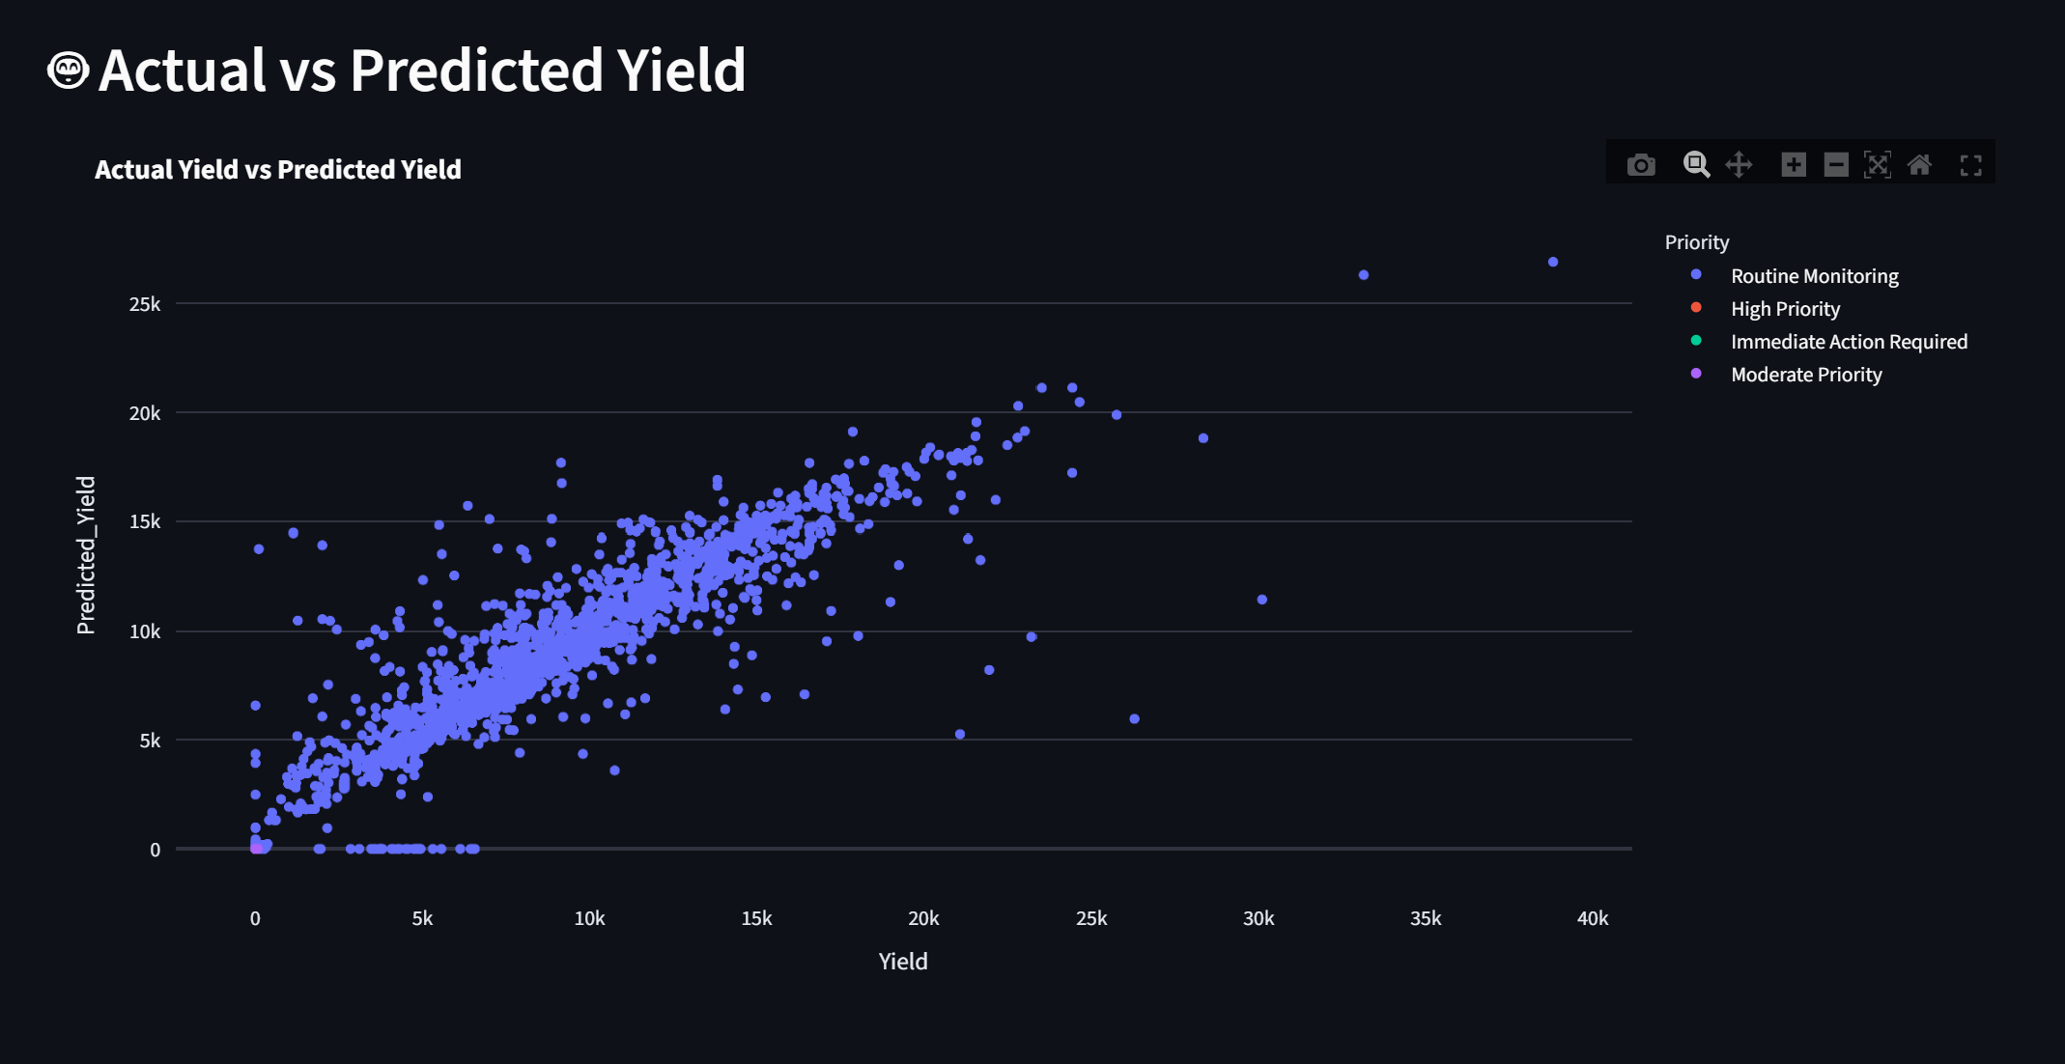
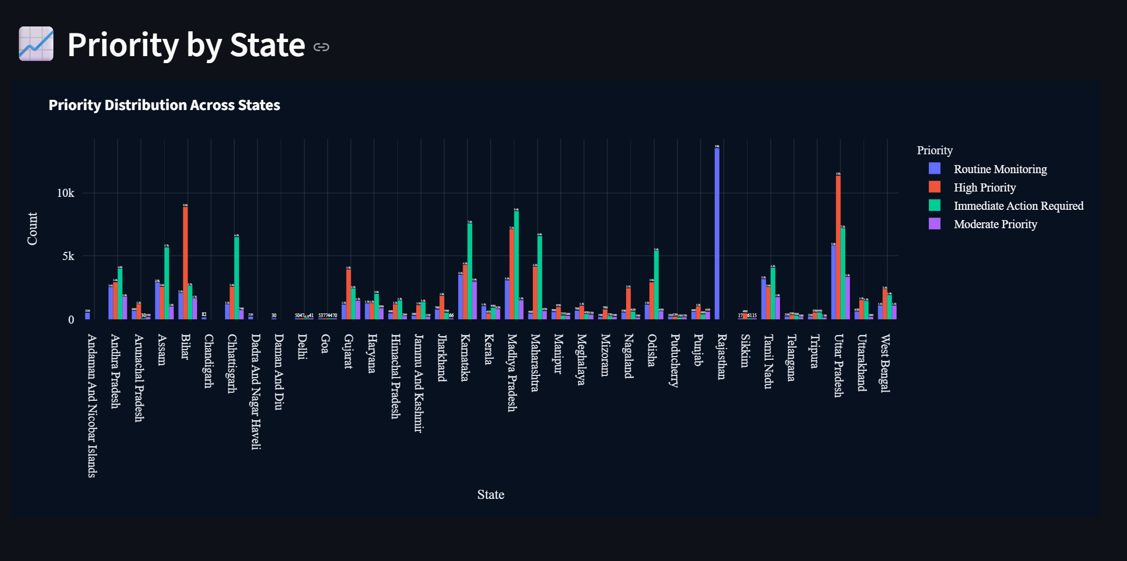
RESULTS & MODEL EVALUATION
Actual vs Predicted Yield
Priority by State
EVALUATION METRICS
MAE
RMSE
R² SCORE
Mean Absolute Error
Root Mean Square Error
Coefficient of Determination
The Random Forest model demonstrates strong correlation between actual and predicted yield values. Absolute Error and Prediction Error metrics are generated to continuously analyze and improve prediction quality.
17 / 20

Slide 16
FUTURE SCOPE
Planned enhancements to expand AgriIntel capabilities
Real-Time Weather API
Satellite Data Integration
IoT Sensor Integration
Live weather data integration for dynamic recommendations
Remote sensing for crop health and land use analysis
Real-time soil moisture and nutrient monitoring
Mobile Application
Multi-language Support
Deep Learning Models
Field-accessible app for farmers on smartphones
Regional language interfaces for wider accessibility
Neural networks for complex pattern recognition
Live Market Price Prediction
Disease Detection (Computer Vision)
Forecast crop prices to help farmers decide what to plant and when to sell
Image-based crop disease identification using CNN models
LLM-BASED AI ASSISTANT
Conversational AI assistant for farmers — ask questions, get recommendations, and receive personalized farming advice
18 / 20

Slide 17
THANK YOU
Q & A
Questions & Discussion
AgriIntel — Empowering Farmers with AI-Driven Intelligence

